Slide 1
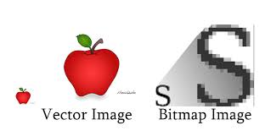
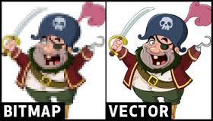
Multimedia building block: Images

Slide 2
Objectives
Discuss the various factors that apply to the use of images in multimedia.
Describe the capabilities and limitations of bitmap images.
Describe the capabilities and limitations of vector images.
Define various aspects of 3D modeling.
Describe the use of colors and palettes in multimedia.
Cite the various file types used in multimedia.

Slide 3
Overview
Creation of multimedia images.
Creation of still images.
Colors and palettes in multimedia.
Image file types used in multimedia.

Slide 4
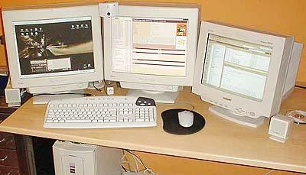
Creation of multimedia images
Images obviously play a very important role in multimedia products
Images may be photograph-like bitmaps, vector-based drawings, or 3D renderings
The type of still images created depends on the display resolution, and hardware and software capabilities.
Access to the right tools and right hardware for image development is important!
E.g., graphic designers like to have large, high-resolution monitors or multiple monitors

Slide 5
Types of Still Images
Still images are generated in two ways:
Bitmaps (or raster-based) .
Vector-drawn graphics.

Slide 6
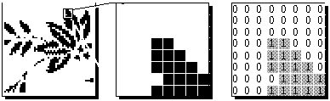
Bitmaps
Bitmap is derived from the words ‘bit’, which means the simplest element in which only two digits are used, and ‘map’, which is a two-dimensional matrix of these bits.
A bitmap is a data matrix describing the individual dots of an image that are the smallest elements (pixels) of resolution on a computer screen or printer.

Slide 7
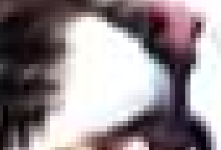
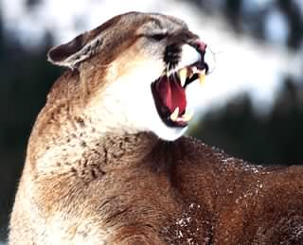
Example

Slide 8
Bitmaps
Bitmaps are an image format suited for creation of:
Photo-realistic images.
Complex drawings.
Images that require fine detail.
Bitmapped images are known as paint graphics.
Bitmapped images can have varying bit and color depths.

Slide 9
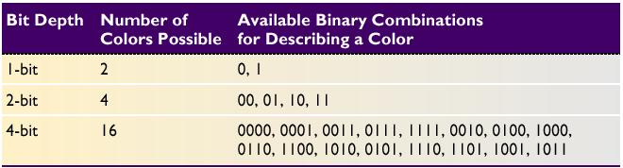
Bitmaps
More bits provide more color depth, hence more photo-realism;
but require more memory and processing power
Available binary Combinations for Describing a Color

Slide 10
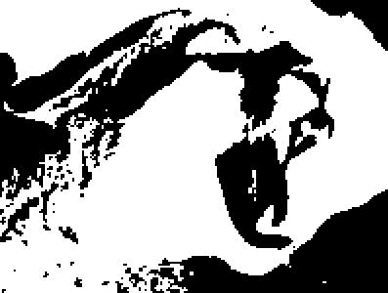
Monochrome just requires one bit per pixel, representing black or white
BMP – 16 KB

Slide 11
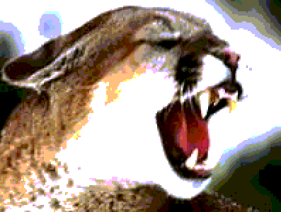
8 bits per pixel allows 256 distinct colors
BMP – 119KB

Slide 12
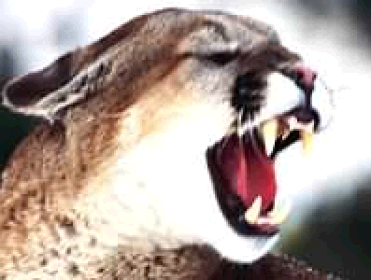
16 bits per pixel represents 32K distinct colors (Most graphic chipsets now supports the full 65536 colors and the color green uses the extra one bit)
BMP – 234 KB

Slide 13

24 bits per pixel allows millions of colors
32 bits per pixel – trillion of colors
BMP – 350KB

Slide 14
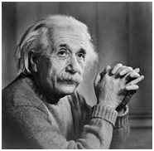
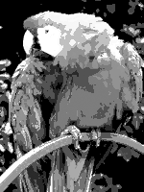
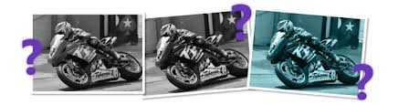
Monochrome, black and white and gray scale image:

Slide 15
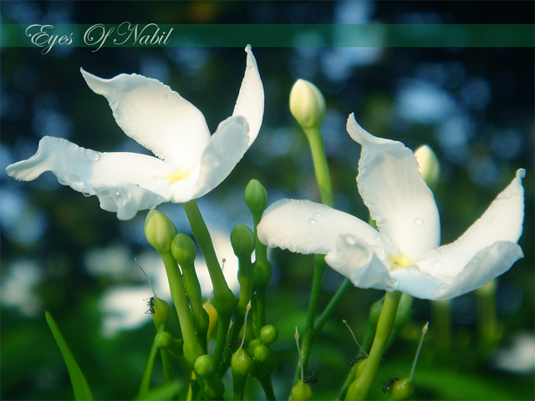
Bitmaps are best for photo-realistic images or complex drawings requiring fine detail

Slide 16

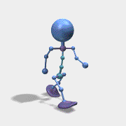


Bitmaps picture and their suitability of use:-
Use the native Microsoft bmp format as a raw image that will later be processed. It faster to process.
Use JPEG, for photo sharing on the web because of its size and quality.
GIF is normally used for diagrams, buttons, etc., that have a small number of colours
It is also suitable for simple animation because it supports interlaced images.
PNG is almost equal to gif except that it didn’t support the animation format.

Slide 17
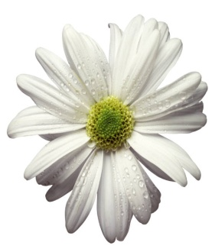
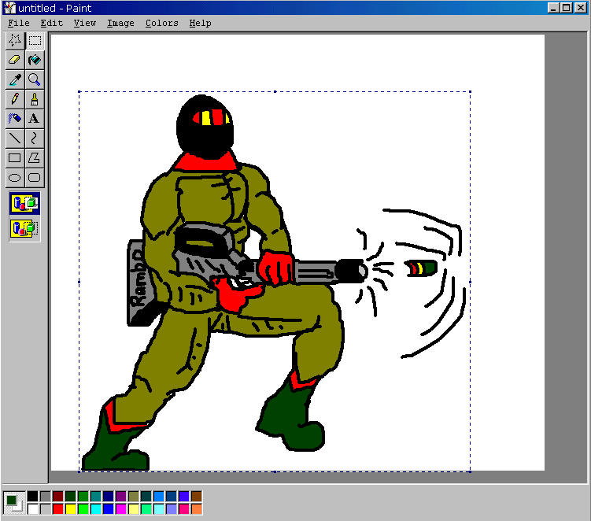
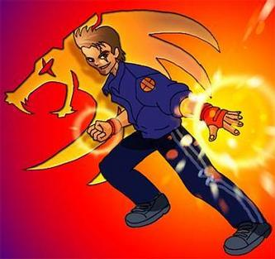
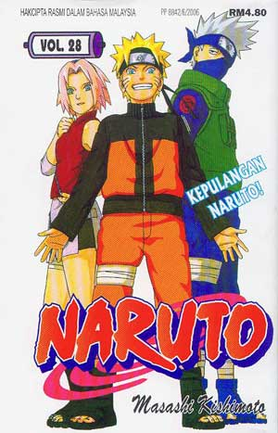
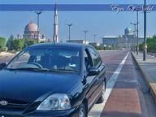
Bitmaps
Bitmaps can be inserted by:
Using clip art galleries.
Using bitmap software.
Capturing and editing images.
Scanning images.
Clip Art
Drawn
Capture
Scan

Slide 18
Using Clip Art Galleries
A clip art gallery is an assortment of graphics, photographs, sound, and video.
Clip arts are a popular alternative for users who do not want to create their own images.
Clip arts are available on CD-ROMs and on the Internet.

Slide 19
Using Bitmap Software
The industry standard for bitmap painting and editing programs are:
Adobe's Photoshop and Illustrator.
Macromedia's Fireworks.
Corel's Painter.
CorelDraw.
Quark Express.

Slide 20
Capturing and Editing Images
Capturing and storing images directly from the screen is another way to assemble images for multimedia.
The PRINT SCREEN button in Windows and COMMAND-CONTROL-SHIFT-4 keystroke on the Macintosh copies the screen image to the clipboard.

Slide 21
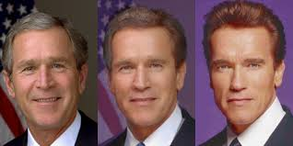
Capturing and Editing Images
Image editing programs enable the user to:
Enhance and make composite images.
Alter and distort images.
Add and delete elements.
Morph (manipulate still images to create animated transformations).

Slide 22
Scanning Images
Users can scan images from conventional sources and make necessary alterations and manipulations.

Slide 23
Applications of Vector-Drawn Images
Vector-drawn images - created from geometric objects such as lines, rectangles, ovals, polygons using mathematical formulas
Vector-drawn images are used in the following areas:
Computer-aided design (CAD) programs.
Graphic artists designing for the print media.
3-D animation programs.
Applications requiring drawing of graphic shapes.

Slide 24
How Vector-Drawn Images Work
A vector is a line that is described by the location of its two endpoints.
Vector drawing makes use of Cartesian co-ordinates.
Cartesian coordinates are numbers that describe a point in two or three-dimensional space as the intersection of X, Y, and Z axis.
Y
Z
X

Slide 25
Example
RECT 0,0,200,300,RED,BLUE says
“Draw a rectangle starting at 0,0 (upper left corner of screen) going 200 pixels horizontally right and 300 pixels downward, with a RED boundary and filled with BLUE.”
200 pixel
300 pixel

Slide 26
Vector-Drawn Images v/s Bitmaps
Vector images use less memory space and have a smaller file size as compared to bitmaps.
For the Web, pages that use vector graphics in plug-ins download faster, and when used for animation, draw faster than bitmaps.
Vector images cannot be used for photorealistic images.
Vector images require a plug-in for Web-based display.
Bitmaps are not easily scalable and resizable.
Bitmaps can be converted to vector images using autotracing.

Slide 27


3-D Drawing and Rendering
3D graphics tools, such as Macromedia Extreme3D, or Form-Z, typically extend vector-drawn graphics in 3 dimensions (x, y and z)
X
Z
y

Slide 28
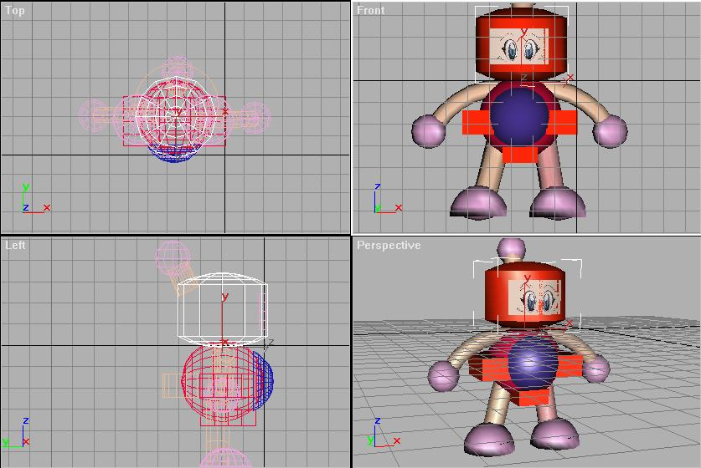
3-D Drawing and Rendering
A 3D scene consist of object that in turn contain many small elements, such as blocks, cylinders, spheres or cones (described in terms of vector graphics)
The more elements, the finer the object’s resolution and smoothness.

Slide 29
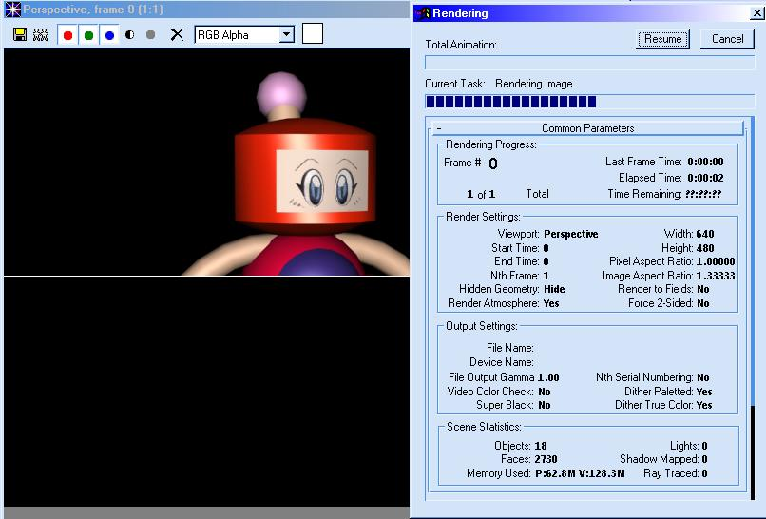
3-D Drawing and Rendering
Objects as a whole have properties such as shape, color, texture, shading & location.
A 3D application lets you model an object’s shape, then render it completely.

Slide 30
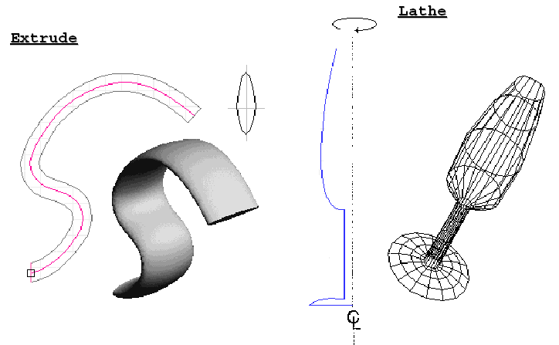
Features of a 3-D Application
Modeling involves drawing a shape, such as a 2D letter, then extruding it or lathing it into a third dimension.
extruding : extending its shape along a defined path
lathing : rotating a profile of the shape around a defined axis

Slide 31
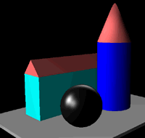
Features of a 3-D Application
Modeling also deals with lighting, setting a camera view to project shadows

Slide 32
Features of a 3-D Application
Rendering : produces a final output of a scene and is more compute-intensive.

Slide 33
3-D Animation Tools
3-D animation, drawing, and rendering tools include:
Ray Dream Designer.
Caligari True Space 2.
Specular Infini-D.
Form*Z.
NewTek's Lightwave.

Slide 34
Natural Light and Color
Light comes from an atom where an electron passes from a higher to a lower energy level.
Each atom produces uniquely specific colors.
Color is the frequency of a light wave within the narrow band of the electromagnetic spectrum, to which the human eye responds.

Slide 35
Understanding Natural Light and Color
The tools we use to describe color are different when the color is printed than from when it is projected
Additive color (projected color).
Subtractive color (printed color).
Monitor-specific color.
Color models.

Slide 36
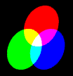
Additive Color
In the additive color method, a color is created by combining colored light sources in three primary colors - red, green, and blue (RGB).
TV and computer monitors use this method.

Slide 37

Subtractive Color
In the subtractive color method, color is created by combining colored media such as paints or ink.
The colored media absorb (or subtract) some parts of the color spectrum of light and reflect the others back to the eye.

Slide 38
Subtractive Color
Subtractive color is the process used to create color in printing.
The printed page consists of tiny halftone dots of three primary colors- cyan, magenta, and yellow (CMY).

Slide 39
Monitor-Specific Colors
Colors should be used according to the target audience's monitor specifications.
The preferred monitor resolution is 800x600 pixels.
The preferred color depth is 32 bits.

Slide 40
Color Models
Different ways of representing information about color.
Models used to specify color in computer terms are:
RGB model - A 24-bit methodology where color is specified in terms of red, green, and blue values ranging from 0 to 255.
HSB and HSL models – Color is specified as an angle from 0 to 360 degrees on a color wheel.
Other models include CMYK, CIE, YIQ, YUV, and YCC.

Slide 41
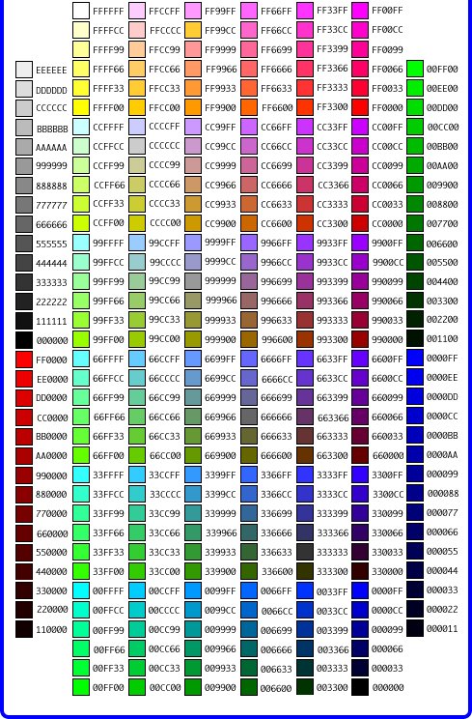
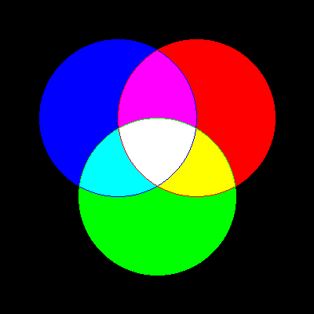
RGB Model
Add red, green and blue to create colors, so it is an additive model.
Assigns an intensity value to each pixel ranging from 0 (black) to 255 (white)
A bright red color might have R 246, G 20, B 50

Slide 42
HSB Model
Based on human perception of color, describe three fundamental properties of color:
Hue
Saturation (or chroma)
Brightness - relative lightness or darkness of color, also measured as %
There is no HSB mode for creating or editing images

Slide 43
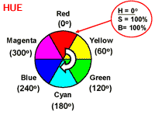
HSB Model
Hue - color reflected from or transmitted through an object, measured on color wheel

Slide 44
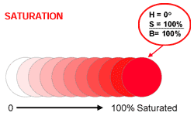
HSB Model
Saturation (or chroma) - strength or purity of color (% of grey in proportion to hue)

Slide 45
HSB Model
Brightness - relative lightness or darkness of color, also measured as %
0%
50%
100%
Black |  |  |  |  |  |  |  |  | white

Slide 46
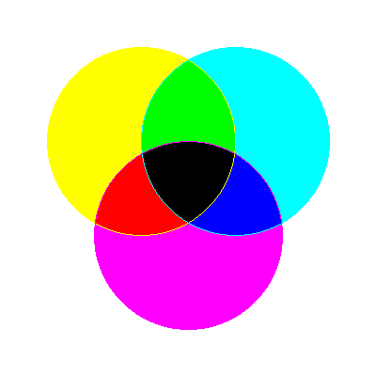
CMYK Model
Based on light-absorbing quality of ink printed on paper
As light is absorbed, part of the spectrum is absorbed and part is reflected back to eyes
Associated with printing; called a subtractive model
Four channels: Cyan (C ), magenta (M), yellow (Y) and black (K)
In theory, pure colors should produce black, but printing inks contain impurities, so this combination produces muddy brown
K is needed to produce pure black, hence CMYK is four-color process printing

Slide 47
Color Palettes
Palettes are mathematical tables that define the color of pixels displayed on the screen.
Palettes are called ‘color lookup tables’ or CLUTs on Macintosh.
The most common palettes are 1, 4, 8, 16, and 24-bit deep.

Slide 48
Color Palettes
Dithering:
Dithering is a process whereby the color value of each pixel is changed to the closest matching color value in the target palette.
This is done using a mathematical algorithm.

Slide 49
Image File Types used in Multimedia
Macintosh formats.
Windows formats.
Cross-platform formats.

Slide 50
Macintosh Formats
On the Macintosh, the most commonly used format is PICT.
PICT is a complicated and versatile format developed by Apple.
Almost every image application on the Macintosh can import or export PICT files.
In a PICT file, both vector-drawn objects and bitmaps can reside side-by-side.

Slide 51
Windows Formats
The most commonly used image file format on Windows is DIB.
DIB stands for Device-independent bitmaps.
The preferred file type for multimedia developers in Windows is Resource Interchange File Format (RIFF).

Slide 52
Windows Formats
Bitmap formats used most often by Windows developers are:
BMP - A Windows bitmap file.
Native bitmap file format of the Microsoft Windows environment
TIFF - Extensively used in DTP packages.
Used to exchange documents between different applications and platforms
PCX - Used by MS-DOS paint software.
One of the oldest bitmapped formats popularized by MS-DOS paint programs that first appeared in the early 1980's

Slide 53
Cross-Platform Formats
The image file formats that are compatible across platforms are:
DXF - Used by CAD applications.
Initial Graphics Exchange Standard (IGS or IGES) - Standard for transferring CAD drawings.
JPEG and GIF - Most commonly used formats on the Web.

Slide 54
Most Popular Image File Formats
JPEG (Joint-Photographic Experts Group)
GIF (Graphical Interchange Format)
PNG (Portable Network Graphic)
Other formats:
BMP, PSD, TIFF/TIF, TGA, EPS, PCX, ICO

Slide 55
Most Popular Image File Formats
JPEG
For continuous tone images, such as full-color photographs
Supports more than 16 millions of color (24-bit)
Uses lossy compression (averaging may lose information)

Slide 56
Most Popular Image File Formats
GIF
For large areas of the same color and a moderate level of detail.
Supports up to 256 colors
Allows transparency and interlacing
Uses lossless compression

Slide 57
Most Popular Image File Formats
PNG
lossless, portable, well-compressed storage of raster images
patent-free replacement for GIF
also replace many common uses of TIFF
Support indexed-color, grayscale, and true color images + an optional alpha channel for transparency

Slide 58
Information Delivery
Images or Graphics are used to convey information in multimedia products.
For example, a picture of an automobile engine is much more effective than text that merely describes it.

Slide 59
Information Delivery
Images or Graphics for information delivery include:
Drawn images
Charts and graphs
Maps
Scenery
People

Slide 60
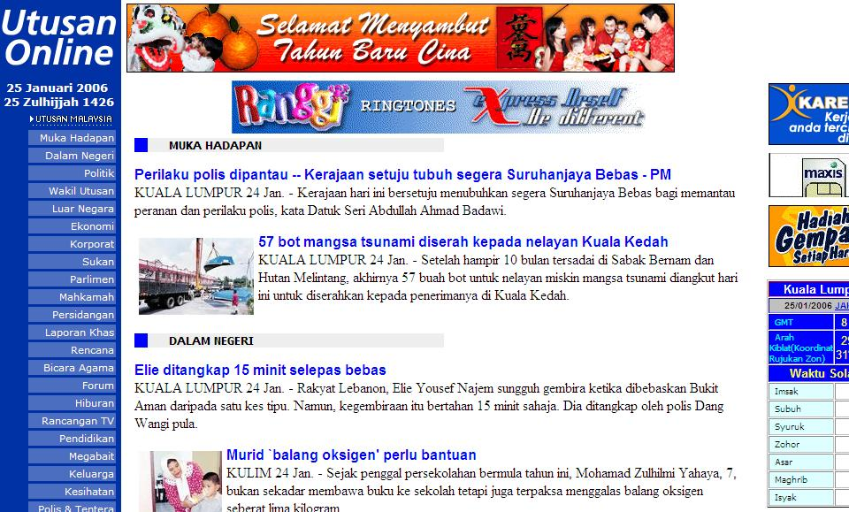
Information Delivery
In each case, the image must be relevant to the overall product.
Image size, color in respect to the application and other images, and positioning must all be considered when using images.

Slide 61
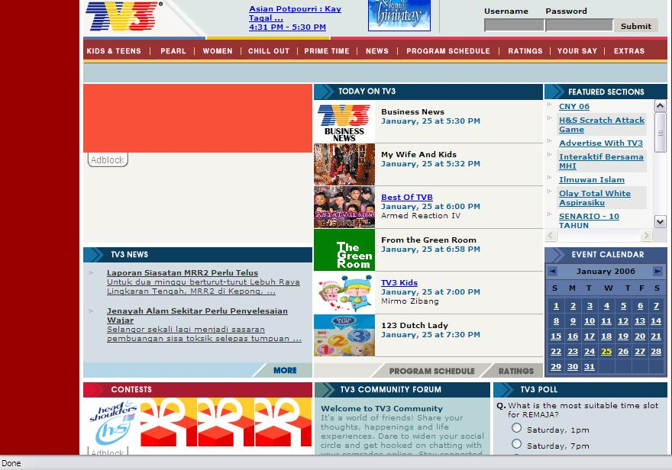
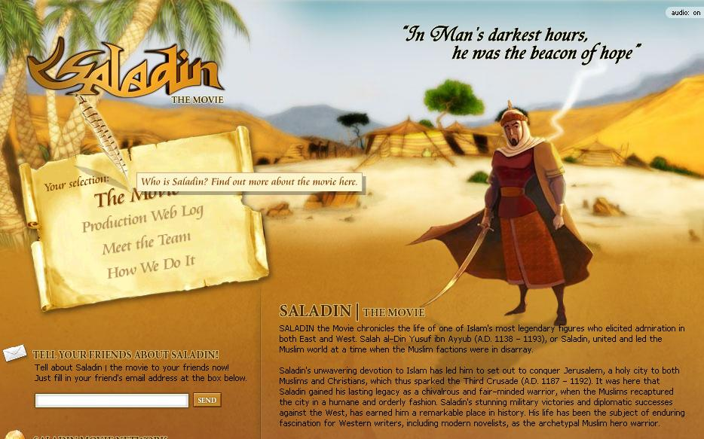
Information Delivery

Slide 62
Summary
The computer generates still images as bitmaps and vector-drawn images.
Images can be incorporated in multimedia using clip arts, bitmap software, or by capturing, editing, or scanning images.
Creating 3-D images involves modeling, extruding, lathing, shading, and rendering.
Color is one of the most vital components of multimedia.

